Slide 1
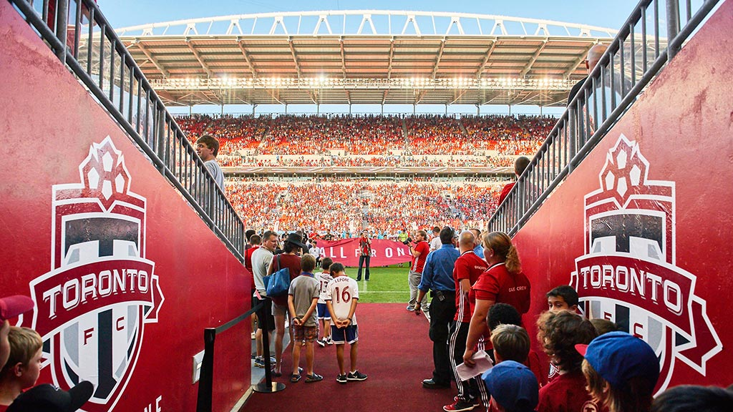

Predictive maintenance for Toronto FC facilities
Presented by

Slide 2

Main Objective
“Toronto FC’s facility management seeks to maintain equipment efficiency while reducing costs and downtime. By leveraging predictive maintenance algorithms, they aim to analyze historical data to anticipate failures and enable proactive repairs, avoiding costly emergency breakdowns”.

Slide 3




Project goals
Task
Mission
To outline the components needed to develop such a solution, highlighting which machine-learning models would be appropriate
To build and predict maintenance for Toronto using a researched Machine Learning model.
Deliverables
Deliverables
● Discuss and define the potential data requirements essential for constructing
predictive maintenance models tailored to Toronto FC’s facility management.
● Select appropriate machine-learning algorithms designed for predictive
maintenance.
● Develop a plan for training and validating the machine-learning models.
● Present outcomes in a visually appealing manner within the project’s portfolio.

Slide 4




Meet the Team
PRESCILA
MORA
CHIBUIKE OKOROAMA
MOHAMED AFTHAB
VENKATA MANISH
KATRAGADDA

Slide 5
Data requirements
Asset Details
Usage & Operational Data
Equipment ID, type, location, and specifications to categorize and assess maintenance needs.
Frequency of equipment use, operating hours, and load data to predict wear and tear.
Maintenance Records
Warranty Information
Historical maintenance activities, dates, costs, and types of repairs to understand failure trends.
Original equipment specifications, warranty coverage, and recommended maintenance cycles.

Slide 6




Important Features
Feature details
Maintenance Status
Usage Hours
Location
Supplier
Usage Days Since Last Maintenance
Usage Hours Since Last Maintenance
Maintenance Frequency (Times)
Failure History
Condition Rating
Equipment Age
10,000 entries of synthetic dataset
19 features

Slide 7

ML Algorithms
Logistic Regression: Suitable for binary classification to predict failure likelihood.
Random Forests: For feature importance analysis and handling complex relationships between variables.
Gradient Boosting: Effective for imbalanced data, where failure events may be rare.
Recurrent Neural Networks (RNNs): Given time-sequenced maintenance data, RNNs can be useful for learning patterns across time.

Slide 8




Logistics Regression
Effective for Binary Classification
Performance with Limited Data
Predictive maintenance often requires distinguishing between two states—whether equipment will fail soon or remain operational. Logistic Regression naturally suits this binary classification, assigning a probability to each outcome (failure or no failure) based on the input features.
Logistic Regression performs well on smaller datasets, whereas complex models like Neural Networks may require large volumes of data to avoid overfitting. If your dataset is limited or if there are fewer instances of failure events, Logistic Regression can still offer useful insights without demanding extensive data. 10,000 entries
Baseline Model
Feature Importance Insight
Logistic Regression can serve as a good baseline model for more complex algorithms. It’s relatively fast to train and evaluate, helping you gauge whether the data has predictive value before moving to more advanced models like Random Forests or Neural Networks.
The model coefficients in Logistic Regression can indicate the importance of different features, helping you identify which factors (such as Last Maintenance, Condition or Equipment Age) are most predictive of failures. This insight can help inform decisions on preventive actions and resource allocation.

Slide 9
Training and Validation
Data Preparation
Train-Test Split
Made sure that the is Clean, encode, and handle missing values. Use methods like SMOTE to address class imbalance.
Divide the data (e.g., 80% training, 20% test) and use cross-validation to enhance reliability
Feature Selection and Scaling
Performance Metrics
Standardize numerical features and select the top-performing features (e.g., SelectKBest) to optimize model efficiency.
Track accuracy, precision, recall, and F1-score. The confusion matrix is also helpful to understand model effectiveness in predicting failures.

Slide 10
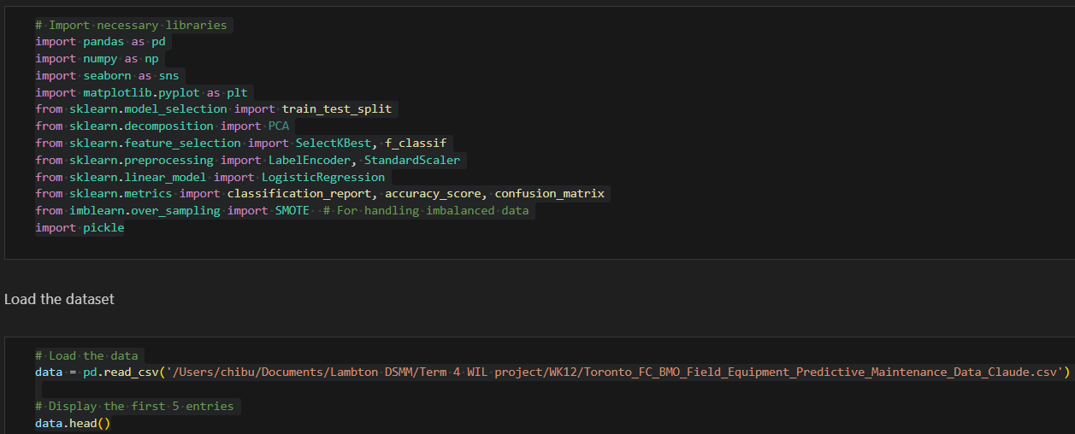
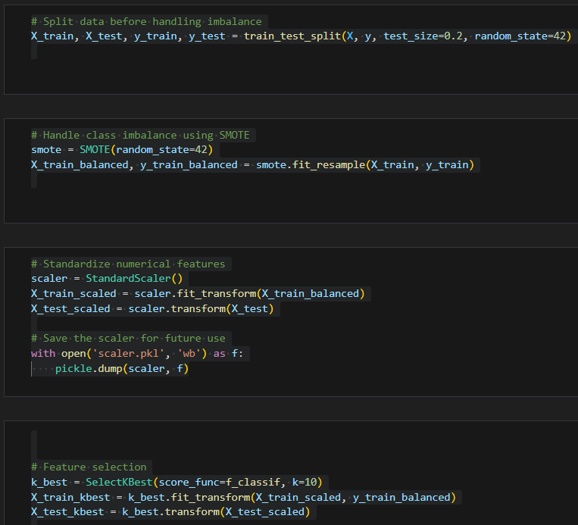
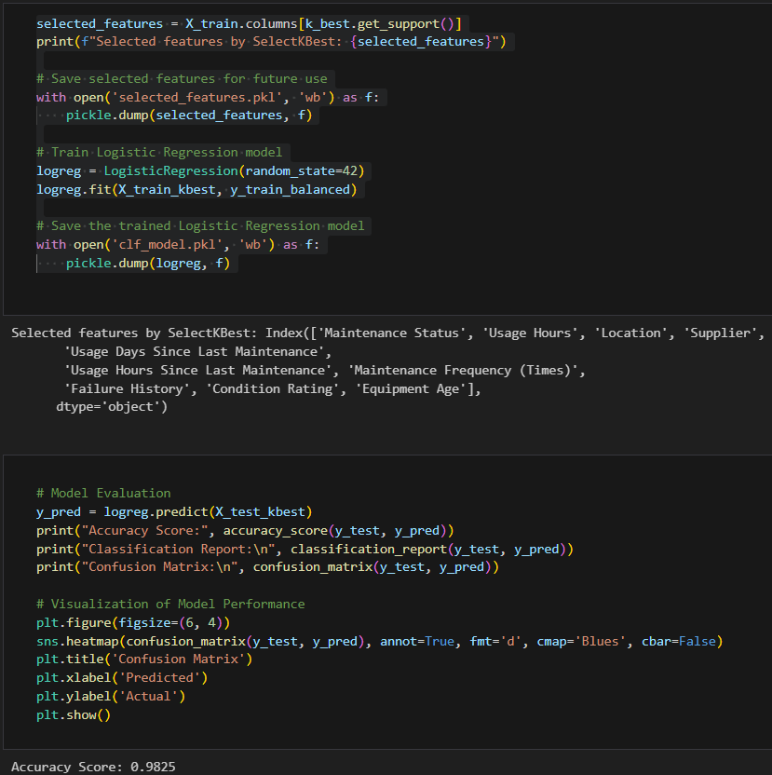
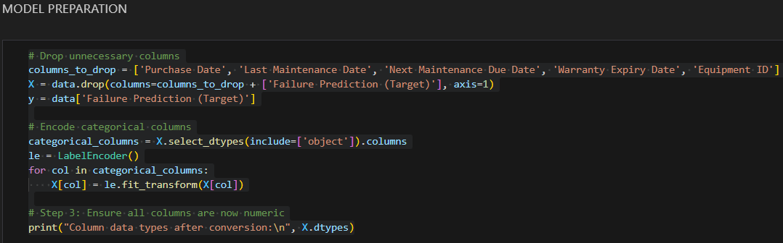
Model code snippet

Slide 11
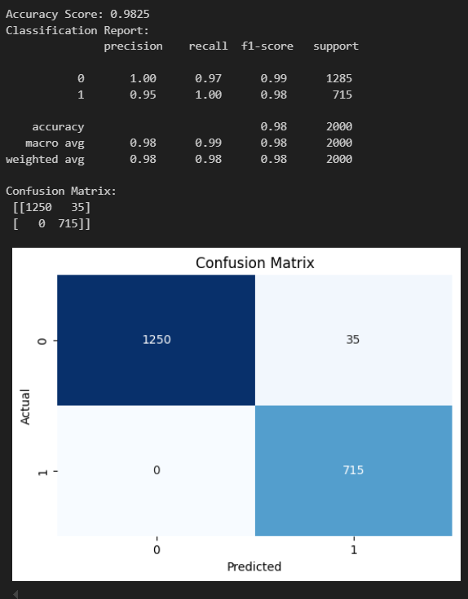

Model result
Logistics Regression achievement
Achieve 98% model accuracy
The model correctly identify equipment that will fail and those that won’t 98% of the time. It’s particularly good at catching potential failures, ensuring timely action to avoid costly downtime.

Slide 12
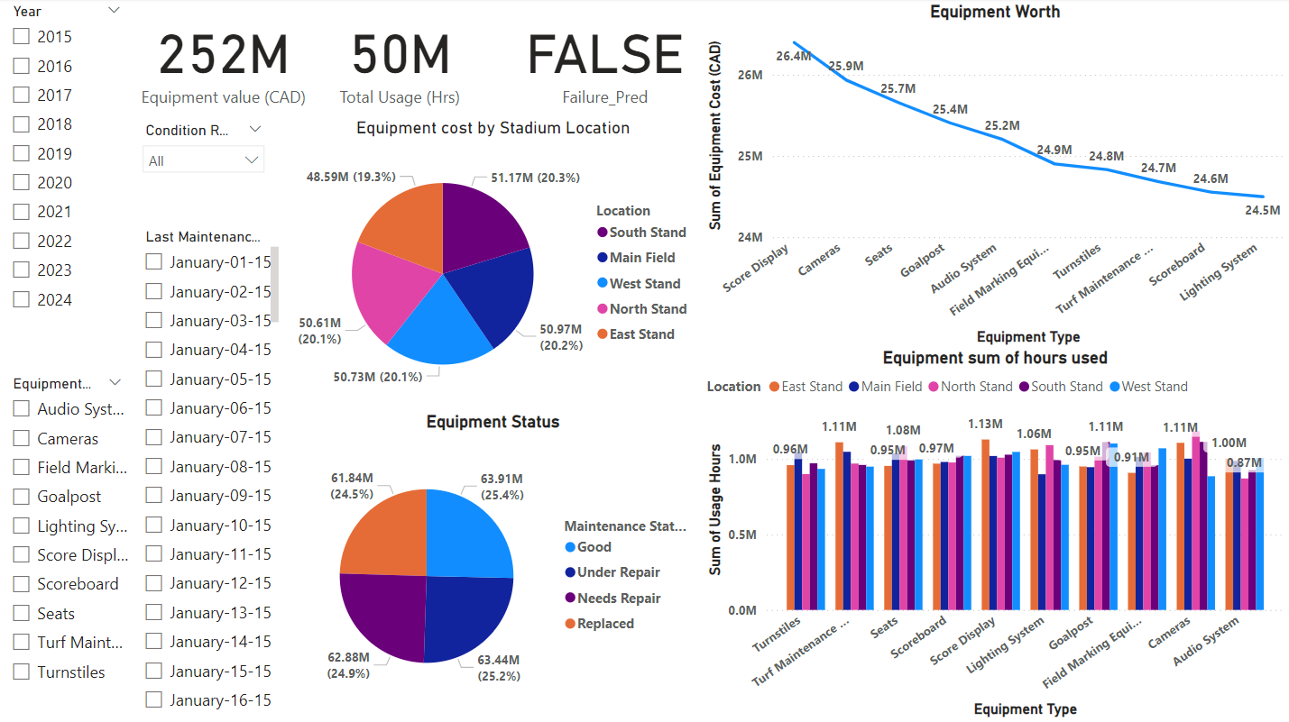

Visualization

Slide 13
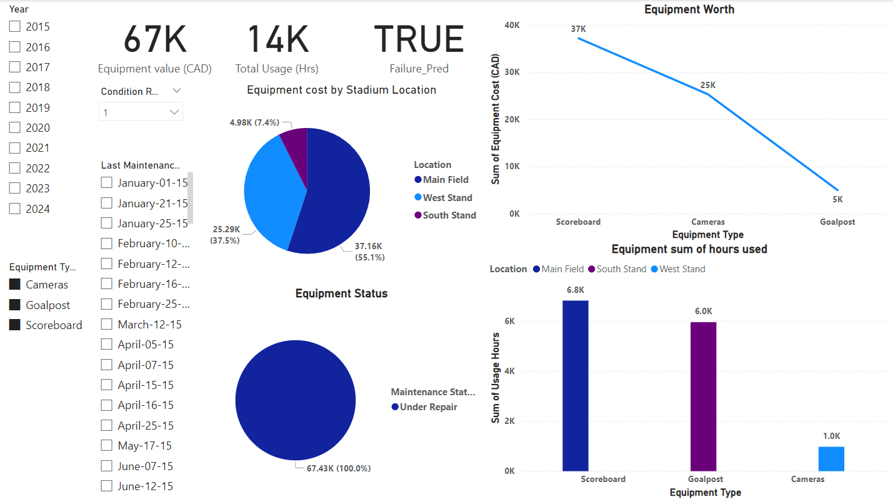
Visualization

Slide 14


Recommendations
Prioritize High-Risk Equipment
Set Maintenance Intervals
Enable Predictive Alerts
Schedule proactive maintenance on high-failure-risk assets.
Use model insights to optimize maintenance timing, reducing emergency costs.
Notify staff in advance of high-risk equipment for timely intervention.

Slide 15
Recommendations
Monitor & Update
Optimize Resources
Continuously refine model parameters for improved accuracy.
Allocate parts and personnel based on predicted maintenance needs.

Slide 16

Conclusion
With a 98.25% accuracy, the model empowers Toronto FC to shift from reactive to preventive maintenance. This approach minimizes unexpected repairs, cuts costs, and enhances facility efficiency.

Slide 17

Thank
You

Slide 18
References
https://tinyurl.com/32c8pszr
https://ieeexplore.ieee.org/document/10391130
https://www.researchgate.net/
https://www.mdpi.com/
https://www.microsoft.com/en-us/power-platform/products/power-bi www.youtube.com
www.Python.org
www.chatgpt.org for dataset

Slide 19
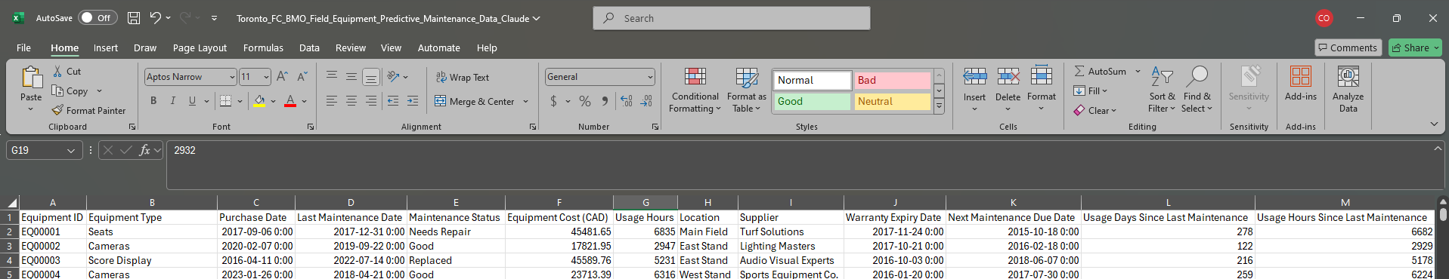
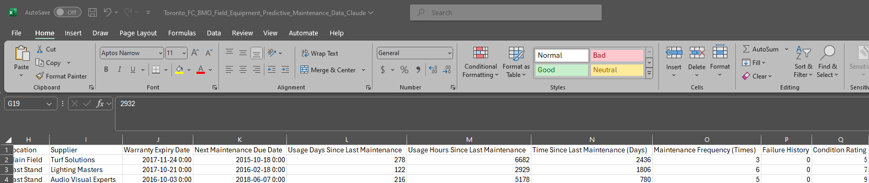
Dataset Snippet

